Slide 1


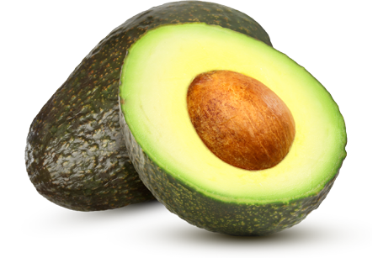


Intro
Avocado Hass
Exported from Colombia
www.Gallonexports.com

Slide 2

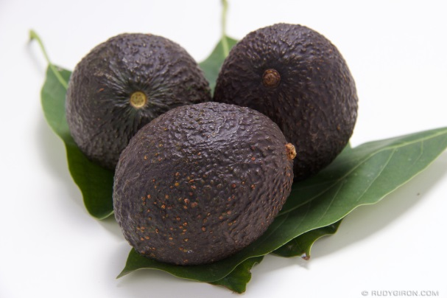
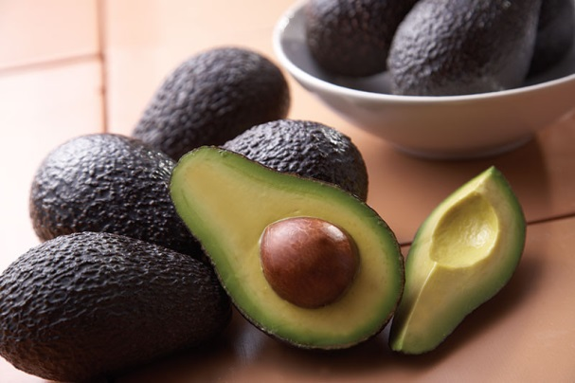
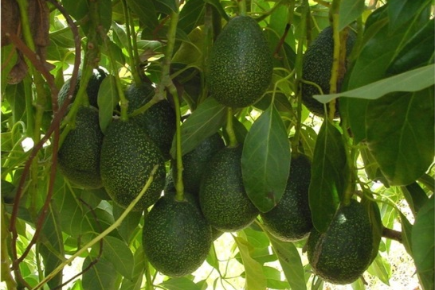
Executive Summary
Gallon Exports, Inc. is an American company with headquarters in Fort Lauderdale, Florida and offices in Colombia. We are a subsidiary of G&G Holdings Group (www.ggholdingsgroup.com) which specializes in the Insurance, Insurance Services, and Export Business segments.
Gallon Exports, Inc. will offer Hass Avocado imports from Colombia to meet increased demand for these products by the city’s growing popular in the greater St. Petersburg/Moscow area.
Gallon Exports, Inc. has been successful over the competition in supplying exported Colombian food products to the area's top wholesalers. From this base, Gallon Exports, Inc. will build a successful business serving the area's large and small markets.

Slide 3




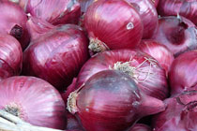
Mission
Gallon Exports, Inc.’s mission is to supply fruits and vegetables to St. Petersburg/Moscow wholesalers which are currently being poorly served by avocado importers located in Israel and Spain.
Raul Gallon, owner of Gallon Exports, Inc., will utilize his exporting background, his experience in the food retail market, as well as his contacts in Russia to bring in products that area customers demand.
The keys to success in Gallon Exports, Inc.’s business are:
Offering items of a high quality-value which are not available everywhere.
Reliable and timely deliveries.
A reliable administration.

Slide 4

Executive Team
Raul Gallon: With a background in International Economics, Exports, and Insurance along with a passion for leadership, success, and team building; Raul Gallon is the President of Gallon Exports, Inc. With his broad depth of learning and results-driven leadership philosophy, Gallon Exports, Inc. has expanded their business to Europe and South America.
As a successful and innovative entrepreneur, Mr. Gallon is also the Chief Executive Officer / President of G&G Holdings Group, LLC (www.ggholdingsgroup.com) – an international investment firm that focuses on exports,
insurance, and insurance services. In Gallon Exports, Inc., Mr. Gallon is responsible for the day-to-day operations as well as quality control and the logistics section of our business.
Mr. Gallon has ten (10) years of exporting experience and is also a licensed and certified Property & Casualty Claims Adjuster, appraisal and umpire along with several insurance certifications. Mr. Gallon has a Bachelor’s Degree in International Economics from Florida Atlantic University.

Slide 5

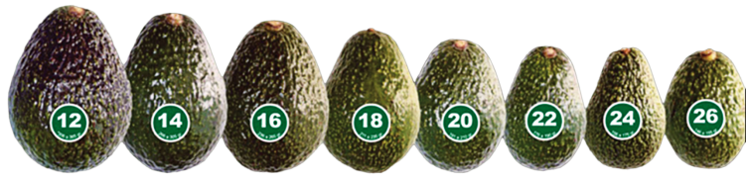
What is Avocado Hass?
The Hass avocado is a cultivar of avocado with dark green, bumpy skin. It was first grown and sold by Southern California horticulturist, Rudolph Hass, who also gave it his name.
The Hass avocado is a large-sized fruit weighing 200-300 grams. When ripe, the skin becomes a dark purplish-black and yields to gentle pressure. When ready to serve, it becomes white-green in the middle part of the inner fruit.
Owing to its taste, size, shelf-life, high growing yield and in some areas, year-round harvesting, the Hass cultivar is the most commercially popular avocado worldwide.

Slide 6
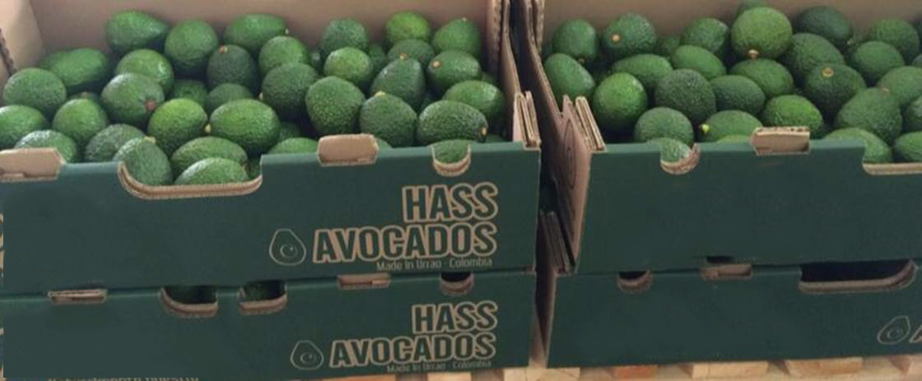
Our main product
Avocado Hass
Hass avocados are high in healthy fats, vitamins C, E and B, potassium, and folic acid.
Nutrient Fiber Vitamin K Folate Pyridoxine (Vitamin B6) Vitamin C Vitamin E Pantothenic Acid Potassium Riboflavin Niacin | Amount 2.00 g 6.30 mcg 27.00 mcg 0.086 mg 2.60 mg 0.590 mg 0.439 mg 152.00 mg 0.043 mg 0.574 mg | Daily Value (%) 8% 8% 6% 4% 4% 4% 4% 4% 4% 4%

Slide 7

Harvest
Avocado Hass
Harvesting is done manually, preferably with scissors; picking fruit individually and keeping a small portion of the stem attached to the fruit.
Appearance: The fruit must be completely healthy; free from physical, mechanical or biological damage, with stalk and greens according to the target market.

Slide 8
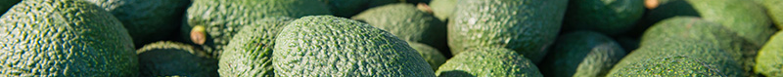
Harvest
Avocado Hass
Hass trees are harvested gently by hand. To separate the fruit from the tree, workers carefully cut the stem of the avocado, using a pole pruner to pick those above arm’s reach. Attached to the pole is a catching basket or bag that captures the harvested Hass, preventing it from falling to the ground and bruising.
Workers then put the fruit into crates, which are whisked off to the packing plant as soon as possible. Time is essential, because once the avocado is plucked from the tree, it starts to ripen.
Warm temperatures speed ripening. To slow that process in the packing house, the avocados quickly go through one of two processes. Some packing houses put them in pools of cool water, washing the avocados while lowering their temperature. Others chill them in specialized rooms and use machinery to brush the field dust off the avocado skin.
Once cleaned, the fruit is sorted by size and boxed in cartons. Hass avocados then are ready for shipping – all in less than a day after they’re harvested.

Slide 9
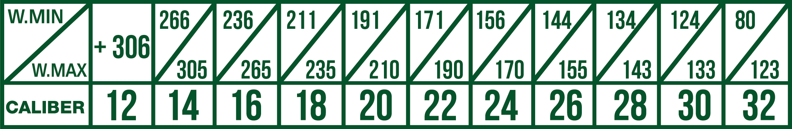
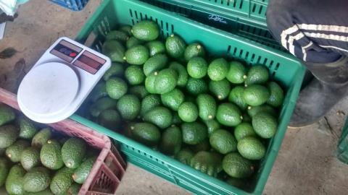
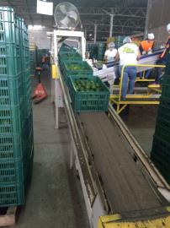
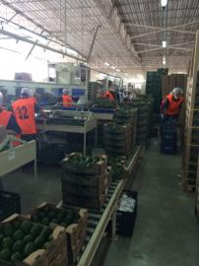
Calibers
Avocado Hass
Our avocados are carefully selected according to their caliber and index of dry matter. Then, we relate the sizes that we sell.

Slide 10
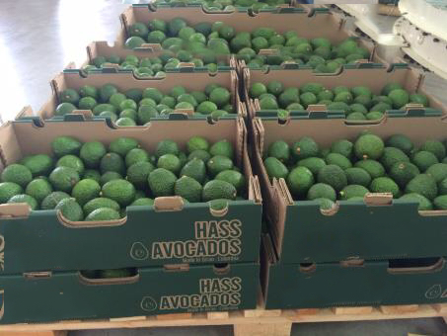
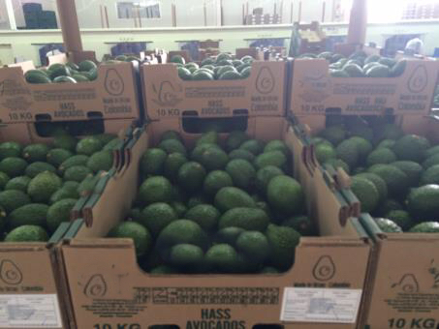
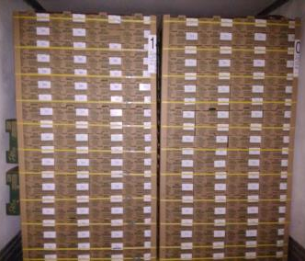
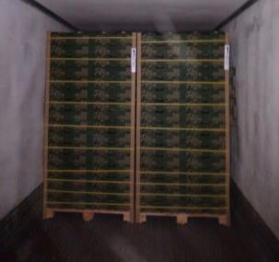

Packing
Avocado Hass
We pack our avocados in groups weighing 4 kg or 10 kg.

Slide 11
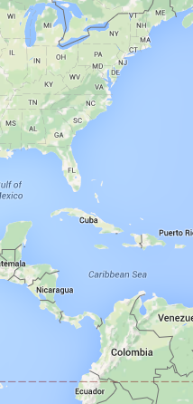
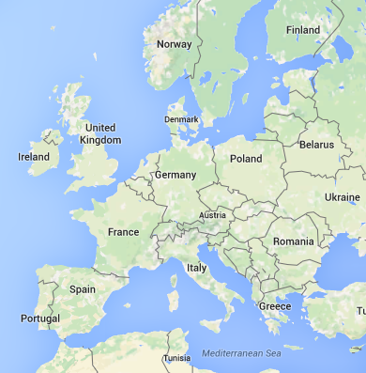
Supply Chain
With Gallon Exports, Inc., you will be able to cut the supply chain significantly as we direct ship to Russia from Colombia, which will:
Increase the number of fresh quality avocados
Reduced pricing of goods
Reduced pricing in logistics
The elimination of third parties in receiving goods
Gallon Exports: Directly
from Colombia – to Russia
Other Suppliers: - From Colombia
- to Spain
- to Russia
We will beat any competitors price

Slide 12
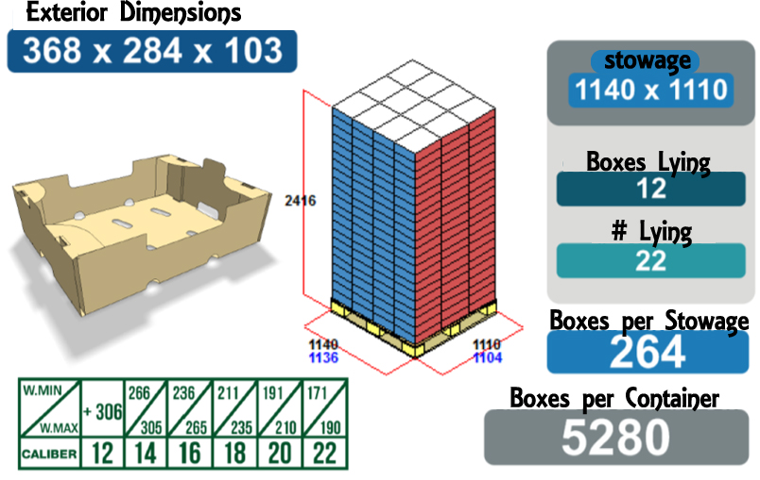
Packing 4 kg
Avocado Hass

Slide 13
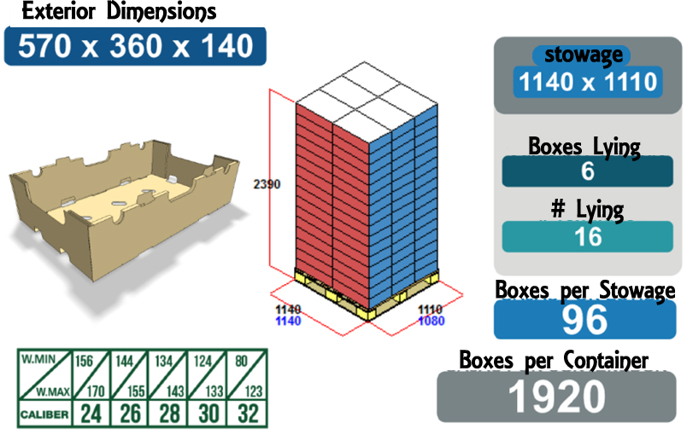
Packing 10 kg
Avocado Hass

Slide 14
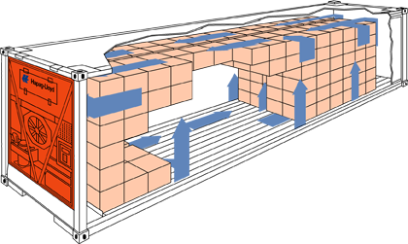

Capacity
Avocado Hass
Gallon Exports, Inc. can ship a minimum of 1 container and a maximum of 30 containers of avocados per month.

Slide 15


Payment Terms
Gallon Exports, Inc. is willing to negotiate terms such as timeliness of payment upon receipt of delivery. We would like to agree on terms that will benefit all parties.
Please direct questions to:
Raul Gallon
954-783-108
rgallon@GallonExports.com

Slide 16
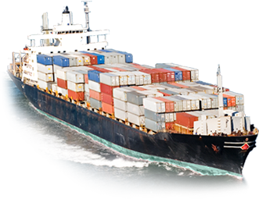



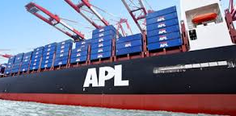
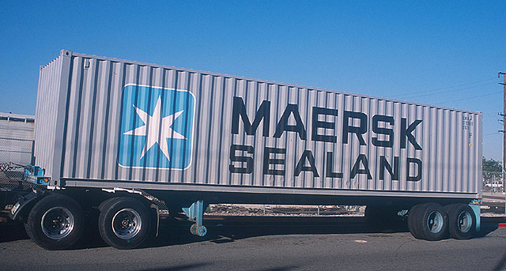
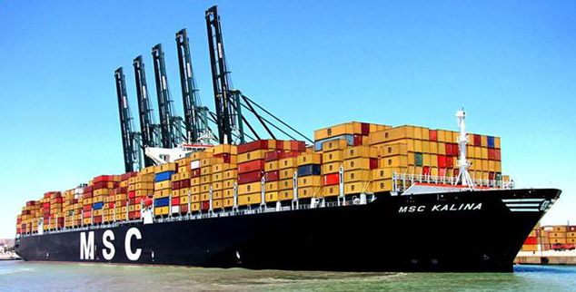
Shipping
The produce is shipped by internationally known carriers such as APL, Maersk Sealand, Mediterranean, CMA CGM, and others. Interior shipments are made by rail and trucks.

Slide 17
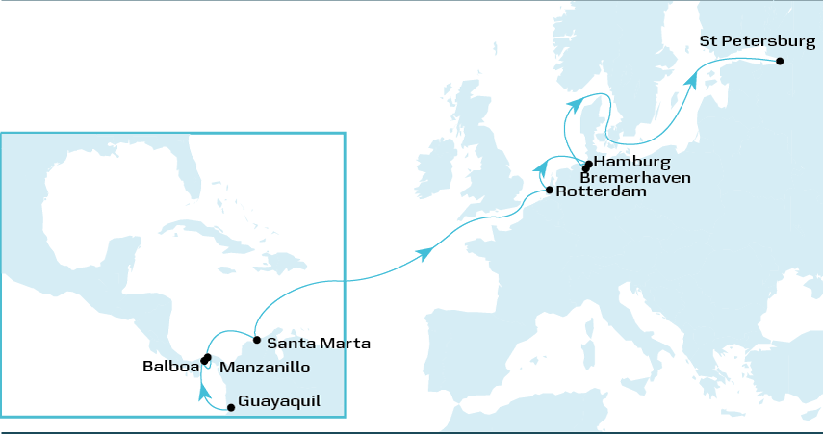
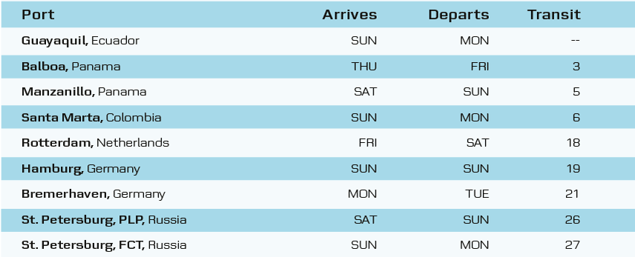
Maersk
Shipping Route
TOTAL TIME: approx. 20 days
Load Port | Discharge Port | Approx. Transit Time
Santa Marta, Colombia | St. Petersburg, Russia | 20 Days

Slide 18
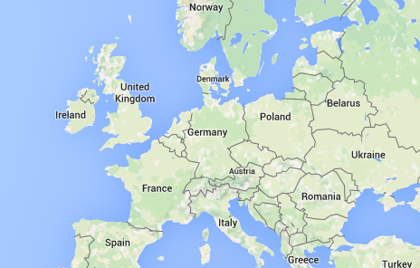
APL
Shipping Route
Step 1:
Cartagena, Colombia to New York, NY
Time: 9 Days
Step 2:
New York, NY to
St. Petersburg, Russia
Time: 28 Days
TOTAL TIME: approx. 37 days
Load Port | Discharge Port | Approx. Transit Time
Cartagena, CO | New York, NY Container Terminal | 9 Days
New York, NY Container Terminal | St. Petersburg, Russia 1st Container Terminal | 28 days

Slide 19
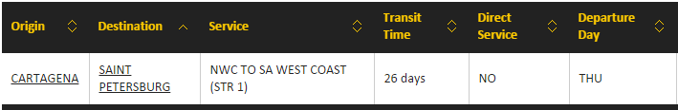
Mediterranean
Shipping Route
TOTAL TIME: approx. 26 days

Slide 20
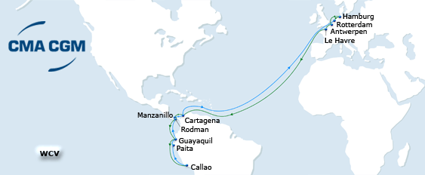
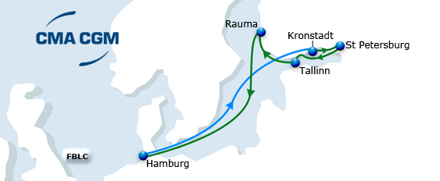
CMA CGM
Shipping Route
Step 1:
Cartagena, CO to Hamburg, DE
Time: 13 Days
Step 2:
Hamburg, DE to
St. Petersburg, RU
Time: 5 Days
TOTAL TIME: approx. 18 days
Load Port | Discharge Port | Approx. Transit Time
Cartagena, Colombia | St. Petersburg, Russia | 18 Days

Slide 21
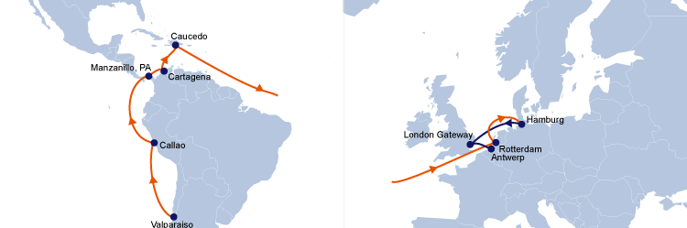
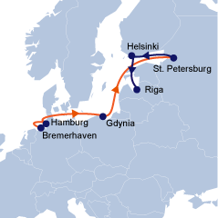
Hapag-Lloyd
Shipping Route
Step 1:
Cartagena, CO to Hamburg, DE
Time: 14 Days
Step 2:
Hamburg, DE to
St. Petersburg
Time: 4 Days
TOTAL TIME: approx. 18 days
Load Port | Discharge Port | Approx. Transit Time
Cartagena, Colombia | St. Petersburg, Russia | 18 Days

Slide 22
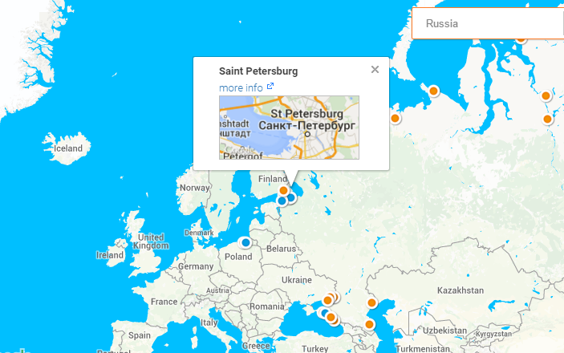
Ports
Russian Port

Slide 23
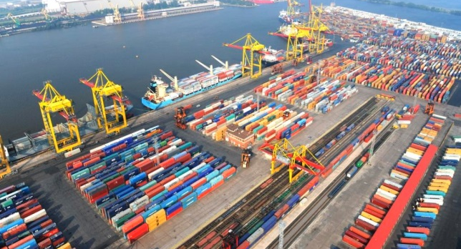
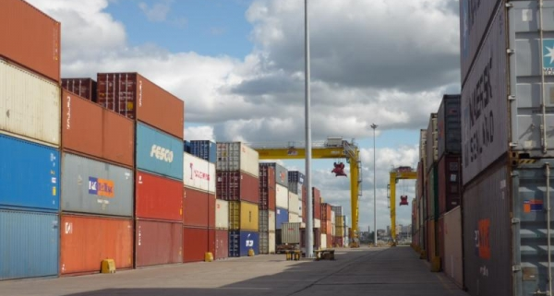
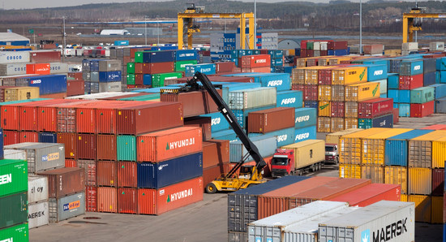
Ports
Other International Ports
DEPARTING PORT
TURBO - COLOMBIA
BARRANQUILLA - COLOMBIA
BUENAVENTURA- COLOMBIA
MAMONAL - COLOMBIA
CIENAGA - COLOMBIA
BOLIVAR - COLOMBIA
CARTAGENA - COLOMBIA
SANTA MARTA - COLOMBIA
ARRIVAL PORT
SAINT PETERSBURG - RUSSIA
ALGECIRAS - SPAIN
UST-LUGA - RUSSIA
ROTTERDAM - HOLLAND
HAMBURGO - GERMANY
NEW ORLEANS - USA
EVERGLADES - USA
AMBERES - BELGIUM

Slide 24


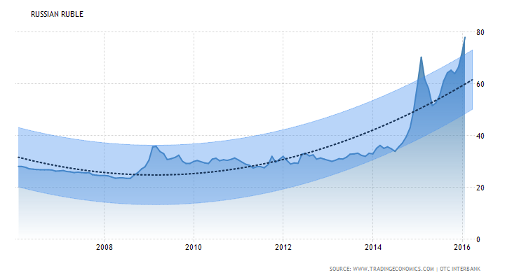
Russian Ruble
Projections
Forecast | Actual | Q1/16 | Q2/16 | Q3/16 | Q4/16 | 2020
Currency | 78.34 | 75.09 | 76.58 | 77.32 | 78.07 | 59.48
Source: http://www.tradingeconomics.com/russia/currency/forecast

Slide 25

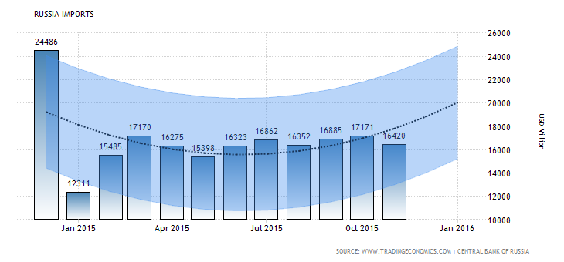
Russian Imports
Projections
Forecast | Actual | Q1/16 | Q2/16 | Q3/16 | Q4/16 | 2020 | Unit
Imports | 16420 | 13820 | 16820 | 16500 | 16826 | 25792 | USD Million
Source: http://www.tradingeconomics.com/russia/imports/forecast

Slide 26

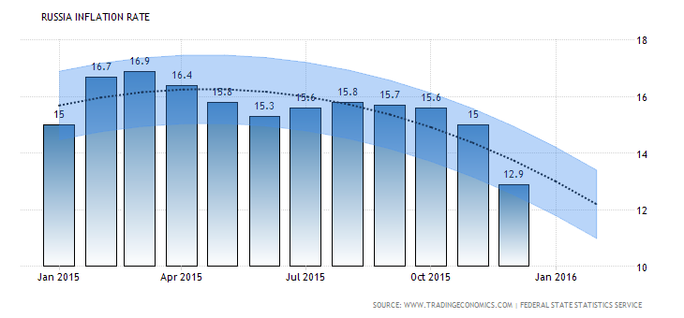
Russian Inflation Rate
Projections
Forecast | Actual | Q1/16 | Q2/16 | Q3/16 | Q4/16 | 2020 | Unit
Inflation Rate | 12.9 | 8.3 | 8.9 | 8.4 | 8.1 | 4.5 | Percent
Source: http://www.tradingeconomics.com/russia/inflation-cpi/forecast

Slide 27
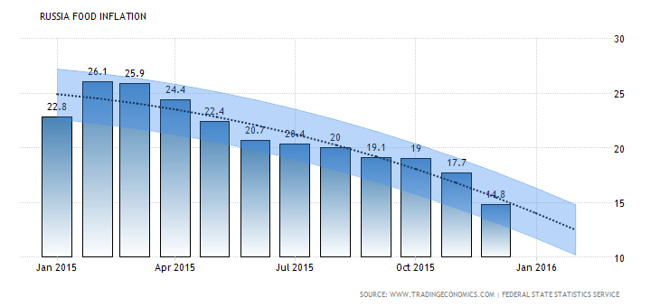
Russian Food Inflation
Projections
Forecast | Actual | Q1/16 | Q2/16 | Q3/16 | Q4/16 | 2020 | Unit
Food Inflation | 14.8 | 11 | 7.91 | 6.8 | 11.35 | 5.7 | Percent
Source: http://www.tradingeconomics.com/russia/food-inflation/forecast

Slide 28

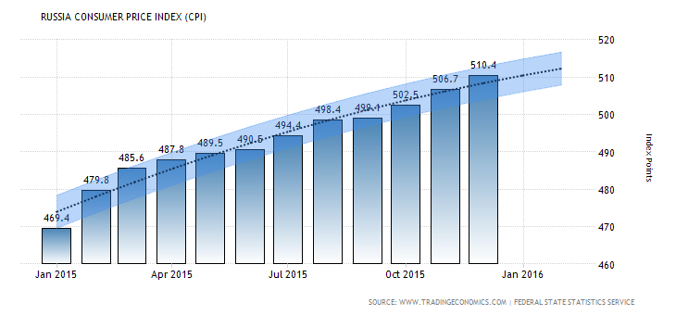
Russian Consumer Price Index
Projections
Forecast | Actual | Q1/16 | Q2/16 | Q3/16 | Q4/16 | 2020 | Unit
Consumer Price Index | 510 | 505 | 522 | 530 | 540 | 622 | Index Points
Source: http://www.tradingeconomics.com/russia/consumer-price-index-cpi

Slide 29


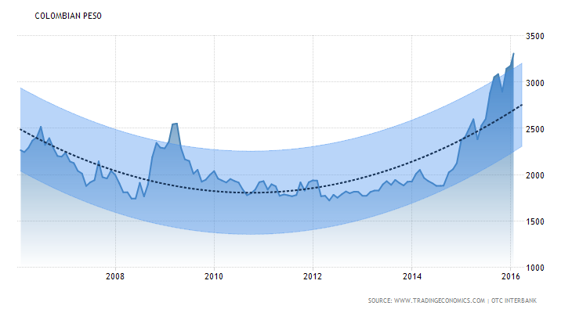
Colombian Peso
Projections
Forecast | Actual | Q1/16 | Q2/16 | Q3/16 | Q4/16 | 2020
Currency | 3310 | 3288 | 3353 | 3386 | 3418 | 2604
Source: http://www.tradingeconomics.com/colombia/currency/forecast

Slide 30
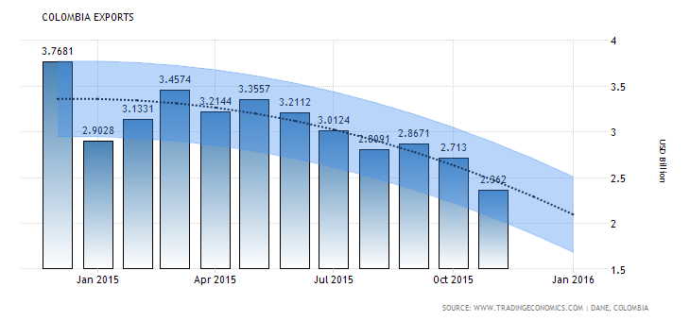
Colombian Exports
Projections
Forecast | Actual | Q1/16 | Q2/16 | Q3/16 | Q4/16 | 2020 | Unit
Exports | 2.36 | 2.5 | 2.48 | 2.5 | 2.5 | 2.49 | USD Billion
Source: http://www.tradingeconomics.com/colombia/exports/forecast

Slide 31

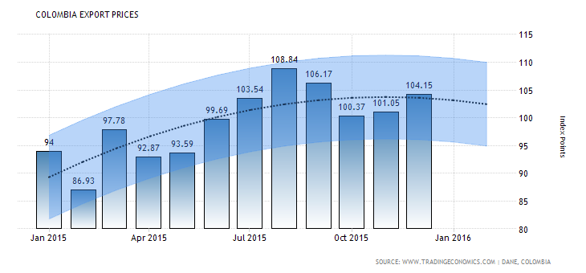
Colombian Export Prices
Projections
Forecast | Actual | Q1/16 | Q2/16 | Q3/16 | Q4/16 | 2020 | Unit
Export Prices | 104 | 105 | 105 | 105 | 105 | 105 | Index Points
Source: http://www.tradingeconomics.com/colombia/export-prices/forecast

Slide 32
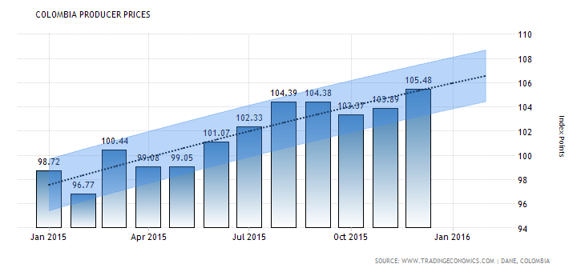
Colombian Producer Prices
Projections
Forecast | Actual | Q1/16 | Q2/16 | Q3/16 | Q4/16 | 2020 | Unit
Producer Prices | 105 | 106 | 106 | 106 | 106 | 106 | Index Points
Source: http://www.tradingeconomics.com/colombia/producer-prices/forecast

